Slide 2
detecting Covid-19 and Pneumonia with chest x-ray images using deep convolational neural networks
Pham Ngoc Tan – 19520925
Vo Khanh An - 19520007

Slide 3
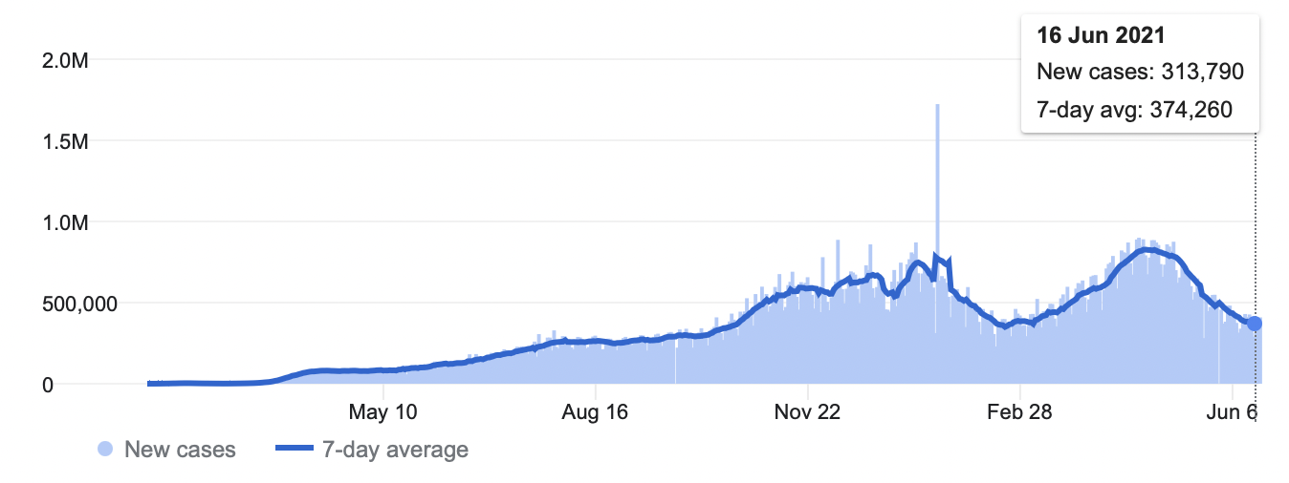
A MINOR LOOKING INTO STATISTICS
According to worldmeters.info, around the world:

Slide 4
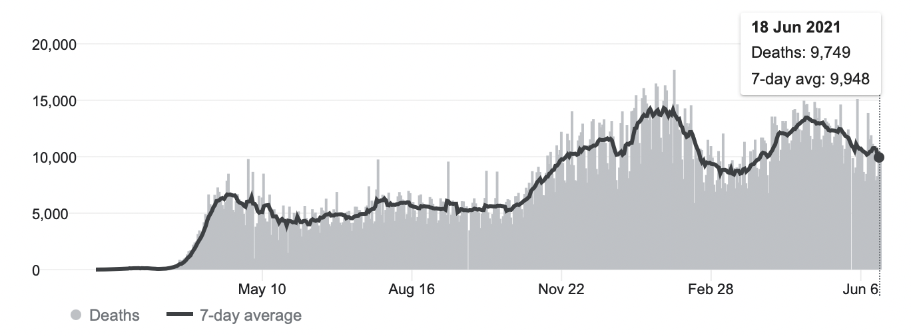
A MINOR LOOKING INTO STATISTICS
According to worldmeters.info, around the world:

Slide 5
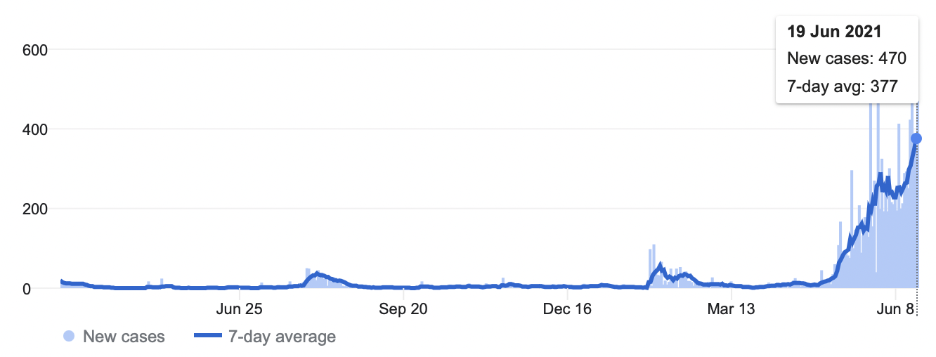
A MINOR LOOKING INTO STATISTICS
According to ncov.moh.gov.vn, in Vietnam:

Slide 6
Real Time Polymerase Chain Reaction

Slide 7
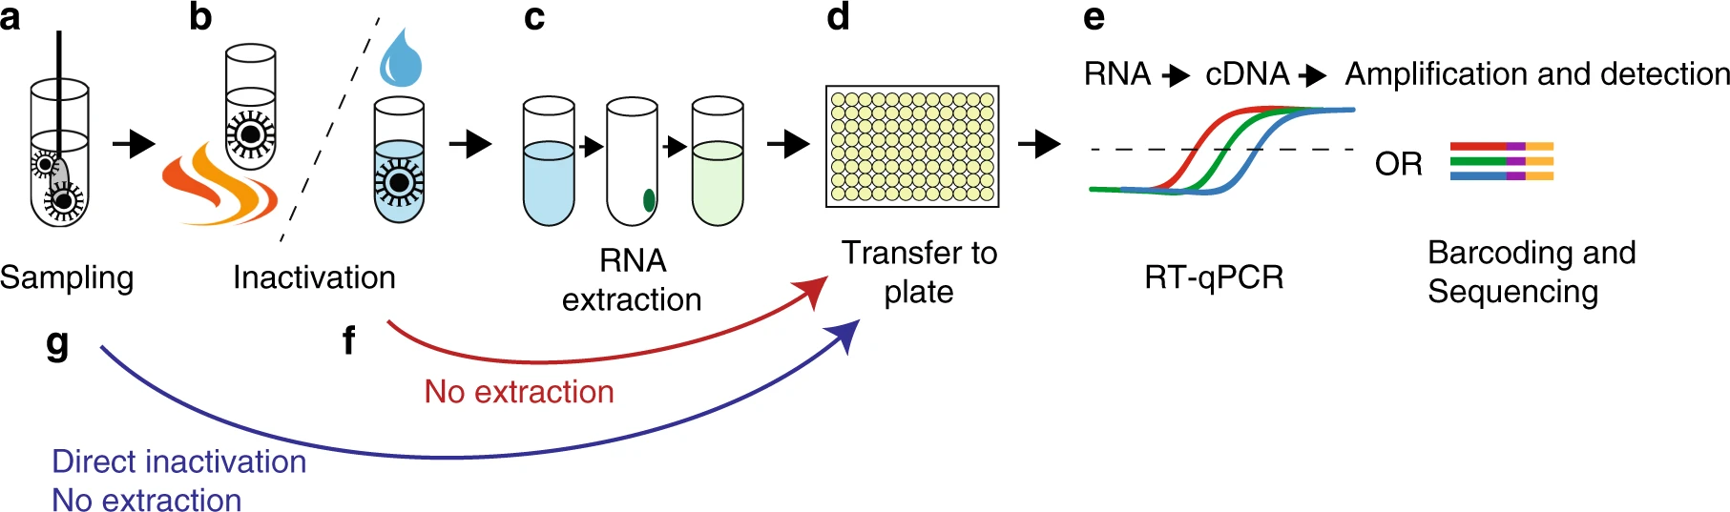
Real Time Polymerase Chain Reaction
Molecularly biological medical test RT PCR can be understood as a testing method detecting specific gene sequences within a complex mixture

Slide 8




Slide 9
Diagnostic imaging Covid19 via CXR

Slide 10
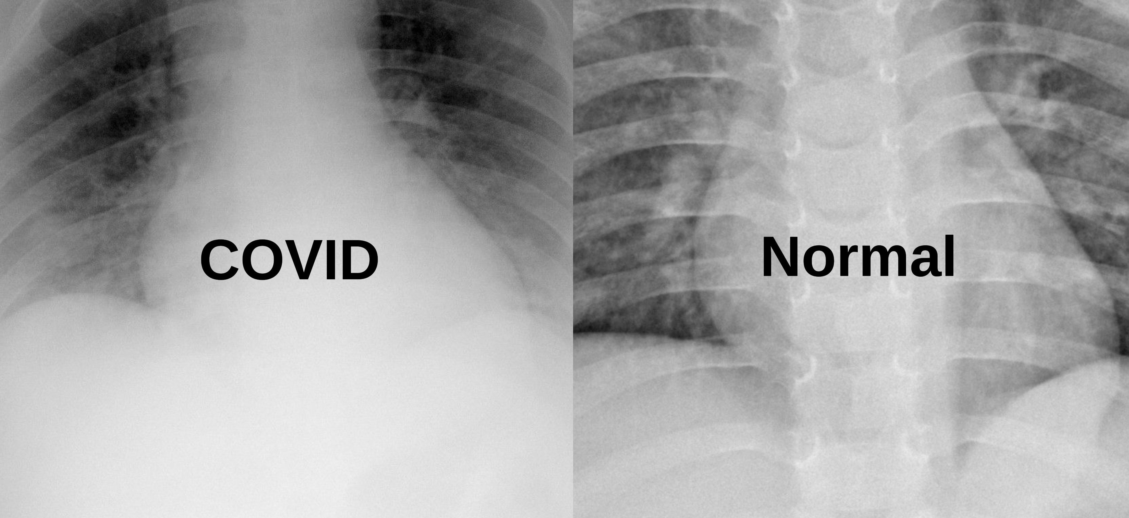
Diagnostic imaging Covid19 via CXR
Why ?
Diagnostic imaging is a relatively faster technique in comparison with the RT PCR
Lower cost, just more than 100 000 VND per examination

Slide 11
Diagnostic imaging Covid19 via CXR
Why not ?
Difficulties in proper diagnosing with only chest X-ray (CXR) images, the technique itself requires other epidemiological characteristics and clinical manifestations for an improved accuracy
Mislead, then ambiguous between COVID-19 and pneumonia as a consequence

Slide 12
Diagnostic imaging Covid19 via CXR
Patient 4780’s case, according to Ministry of Medicine:
58-years-old patient living in district 3 went to Hòa Hảo Medic center for examining
The radiologist there, however, did mis-examine the patient as pneumonia instead of Covid19 through analyzing CXR and CT-scan images
-> Even experts in radiology might mis-examine the cases themselves

Slide 13
Diagnostic imaging Covid19 via CXR
Patient 4780’s case, according to Ministry of Medicine :
58-years-old patient living at district 3 went to Hòa Hảo Medic center for examining
The doctor there, however, did mis-examine the patient as pneumonia instead of Covid19 through analyzing CXR and CT-scan images
-> Thus, AI for this tailored specification is a high recommendation

Slide 14
Diagnostic imaging Covid19 via CXR
Why AI for diagnostic imaging with CXR images ?
Widespread test to identify positive cases first, then recheck by RT PCR
With individuals exposed with COVID-19 or got treatment, it is recommendation use X-ray diagnostic in the treating process until they are negative (with the X-ray diagnostic) and recheck by RT PCR
-> Lower cost
Economize the human resources

Slide 15
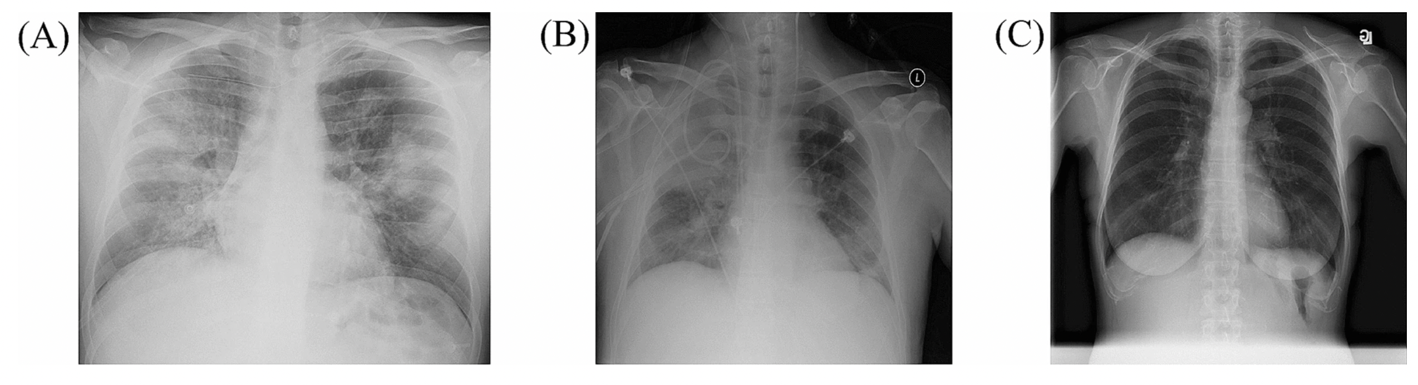
Certain features to classify Covid19 with Pneumonia
Representative CXR images of COVID-19 pneumonia (A), non-COVID-19 pneumonia (B), and the healthy (C)
Generally, similar to pneumonia, the density of lungs is increased in the case of COVID-19, which causes whiteness in the lungs on radiology^{[1]}
An experienced radiologist can confirm the disease by the appearance of a ground-glass pattern due to the increased whiteness
[1] Cleverley, J. et al. (2020)

Slide 16
Introduction to Covidx dataset^{[2-7]}

Slide 17
Data sources
Non-COVID19 pneumonia patient cases and COVID-19 patient cases from the COVID-19 Image Data Collection^{[3]}
COVID-19 patient cases from COVID-19 CXR Dataset Initiative^{[4]}
COVID-19 patient cases from the ActualMed COVID-19 CXR Dataset Initiative^{[5]}
Patient cases who have no pneumonia (i.e. normal) and non COVID-19 pneumonia patient cases from RSNA Pneumonia Detection Challenge dataset ^{[6]}
COVID-19 patient cases from COVID-19 radiography database^{[7]}

Slide 18
COVIDx dataset
20 000 CXR images with 3 classes, which are pneumonia (train: 5963, test: 105), COVID-19 (train: 4649, test: 274) and normal (train: 8751, test: 100) from different patients
[2] provides us a medical-images transfering tools to convert .MRI to .JPEG and combine [3-7] datasets into a consistent set with no unnecessary information

Slide 19
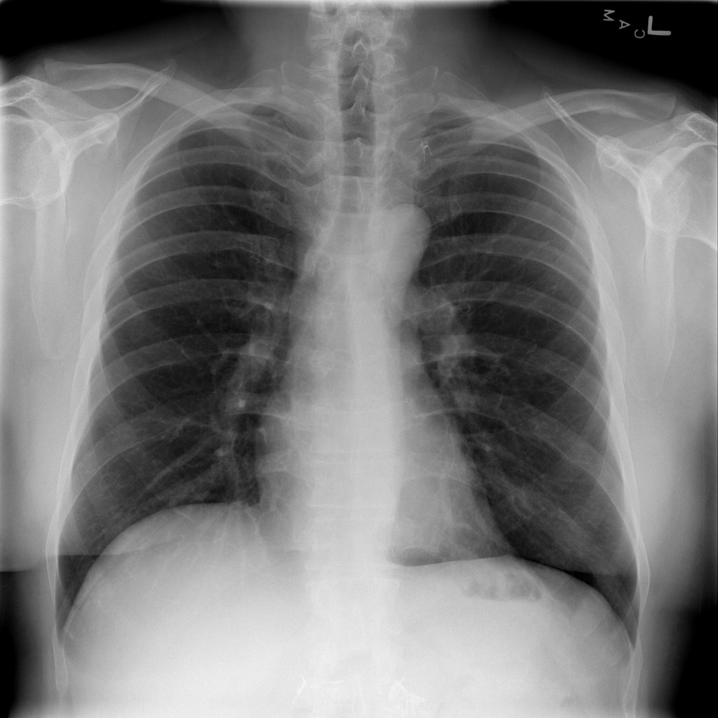
Problem identification
Input: One CXR image
Output: Probability for each class of that CXR image

Slide 20
Solving problem with Deep Convolutional Neural Networks

Slide 21
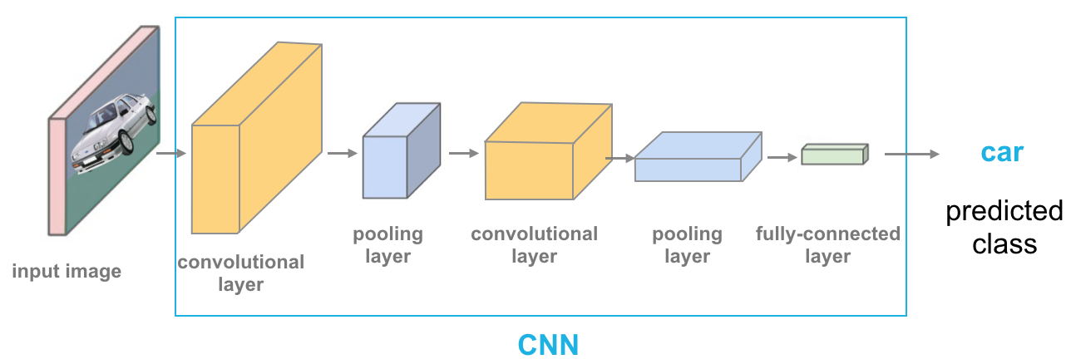
CNNs for classification ^{[7]}
Convolution: Apply filters to generate feature maps
Activation: Often ReLU
Pooling: Down sampling operation on each feature map
Train model with images data
[7] Krizhevsky et al. (2012)

Slide 22
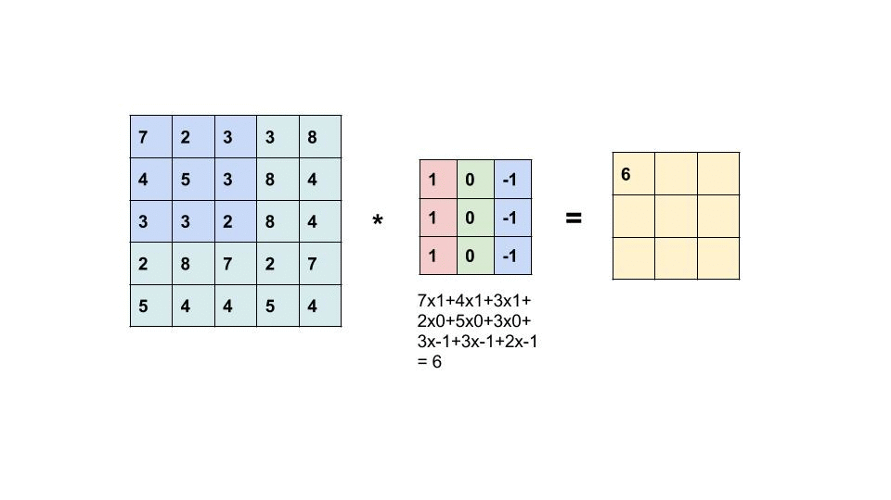
Convolution operation
Learn weights of filters in convolutional layers

Slide 23

Pooling
Stride = 2

Slide 24

Feature learning
CONV and POOL layers output high-level features of input
Fully connected layer uses these features for classifying input image
Express output as probability of image belonging to a particular class

Slide 25
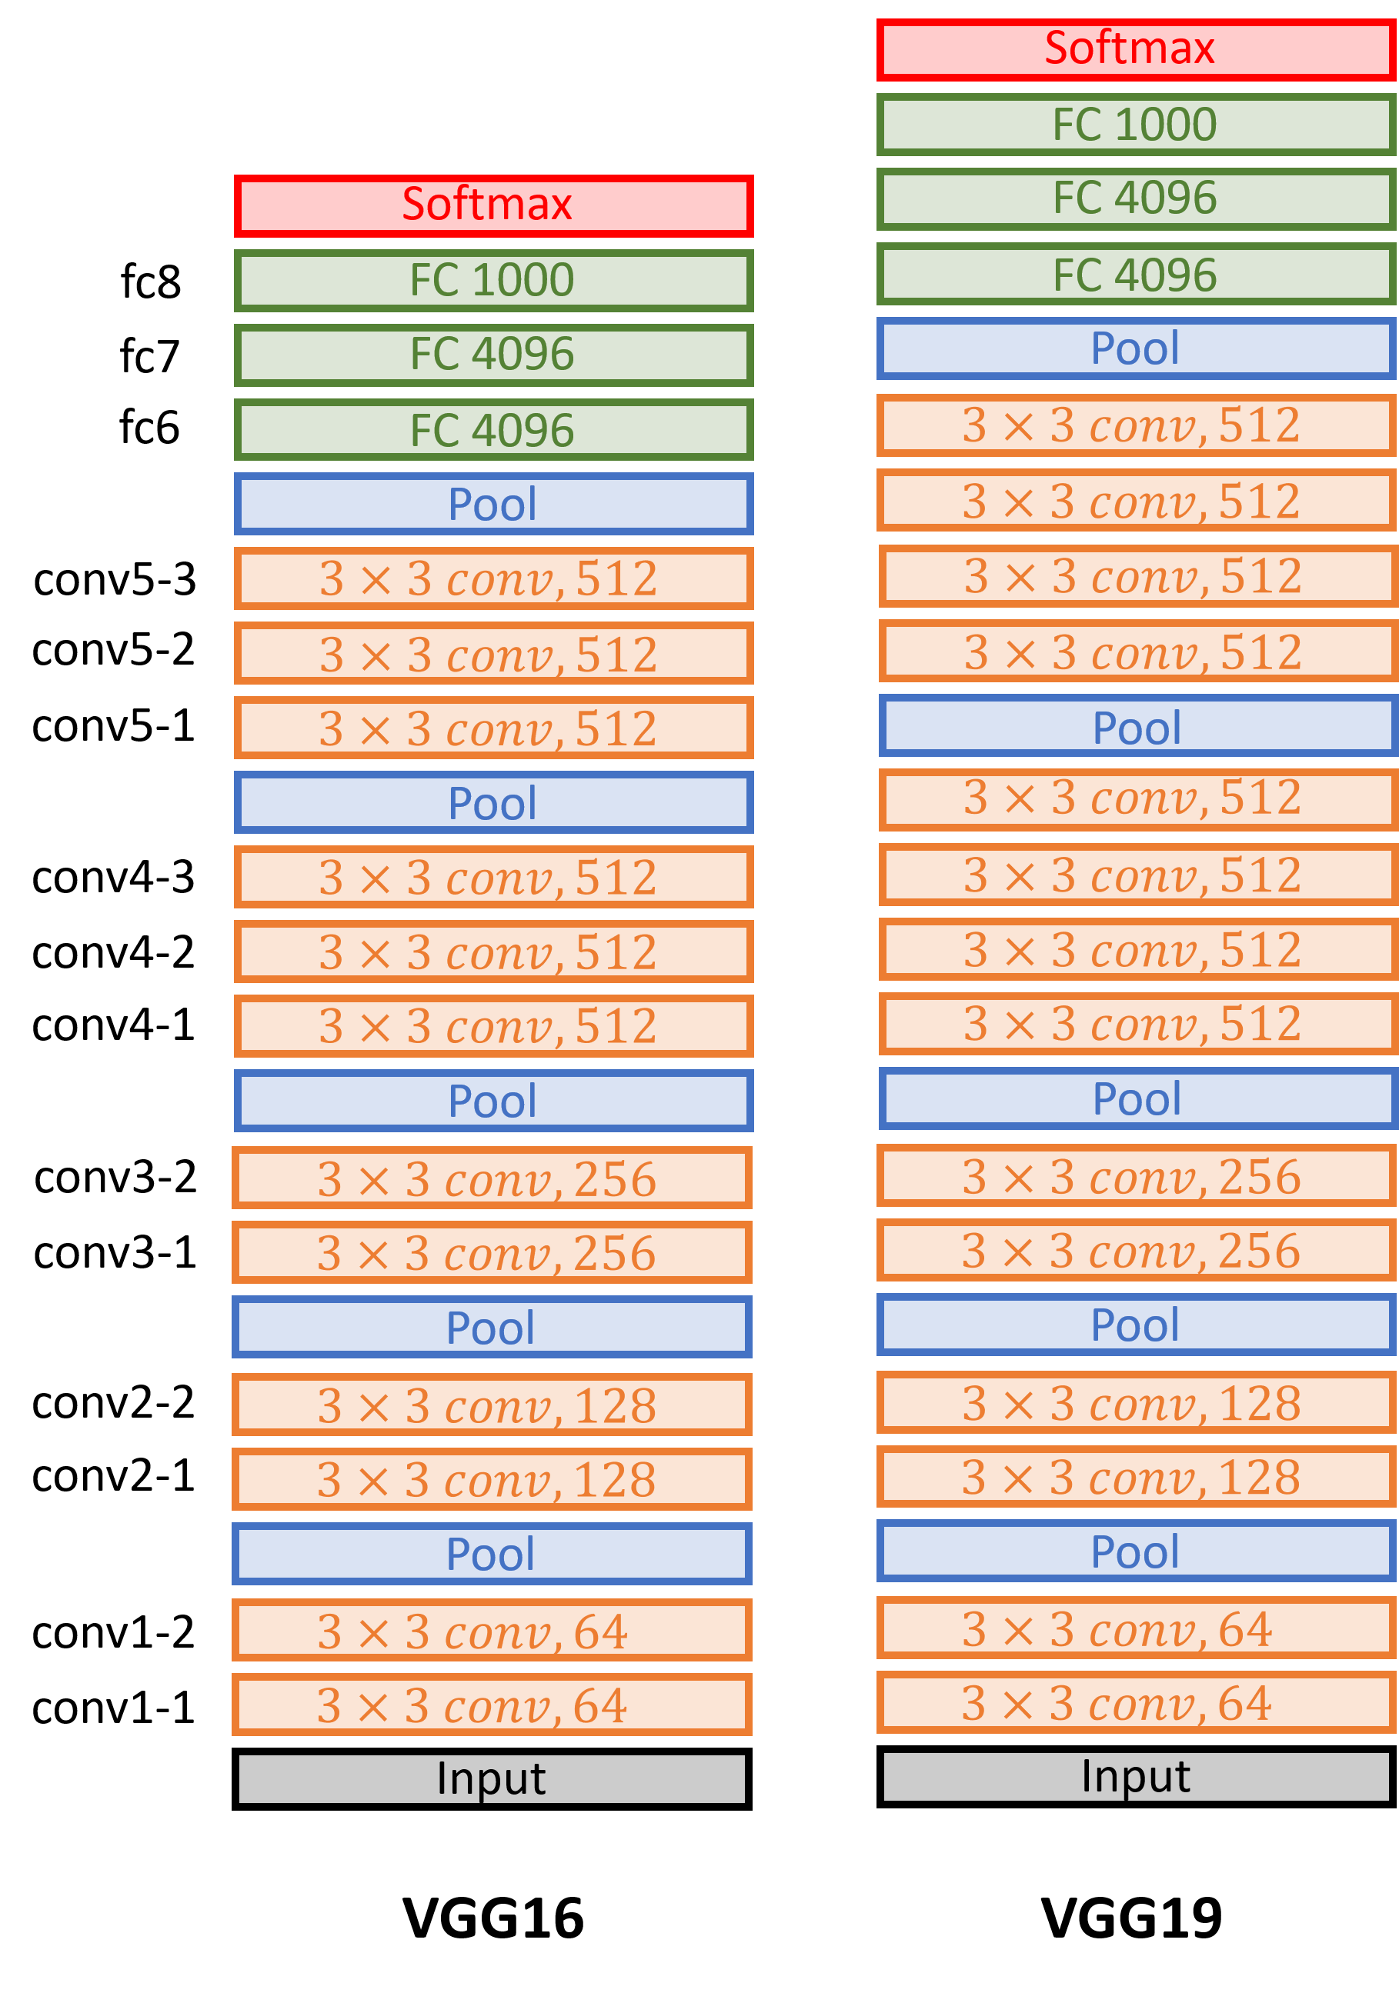
VGG19^{[8]}
[8] K. Simonyan et al., Very deep convolutional networks for large-scale image recognition, 2015.

Slide 26
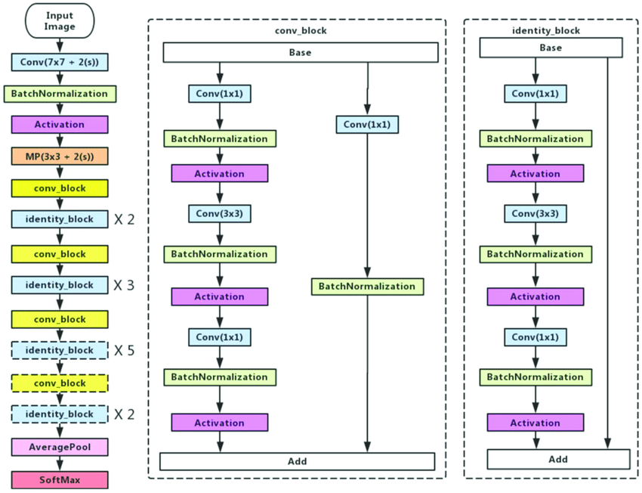
resnet50

Slide 27
Result analysis

Slide 28
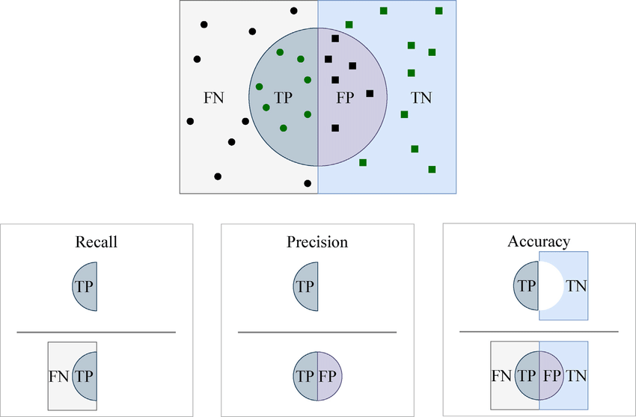
Sensitivity (recall): if a patient has the disease, what is the probability that the model predicts positive ?
Positive predictive value – PPV (precision): if a model prediction is positive, what is the probability that a patient has the disease ?

Slide 29

F1-score:
$$\frac{1}{\frac{1}{2} \left(\frac{1}{recall}+ \frac{1}{precision}\right)}$$

Slide 30
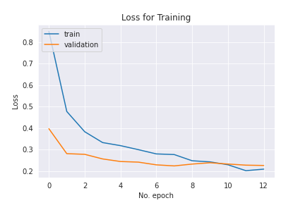
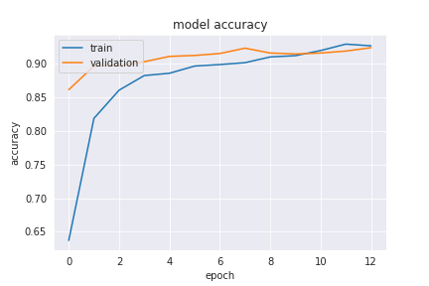
vgg19

Slide 31
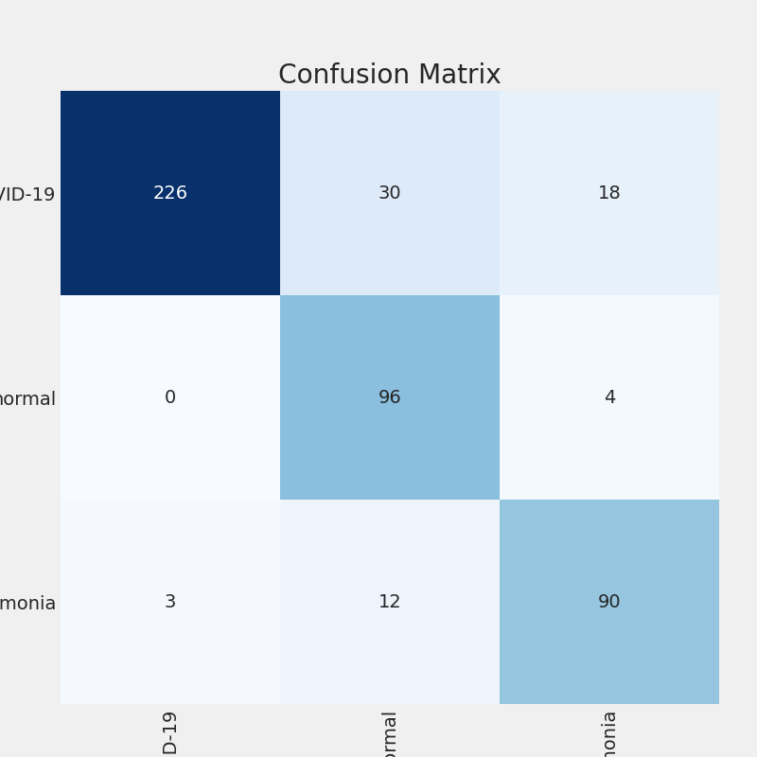
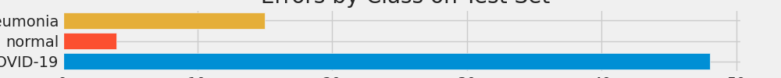
vgg19

Slide 32
vgg19
 | Precision | Recall | F1-score | Support
COVID19 | 0.99 | 0.82 | 0.90 | 274
Normal | 0.7 | 0.96 | 0.81 | 100
Pneumonia | 0.8 | 0.86 | 0.83 | 105
Accuracy: 0.86

Slide 33
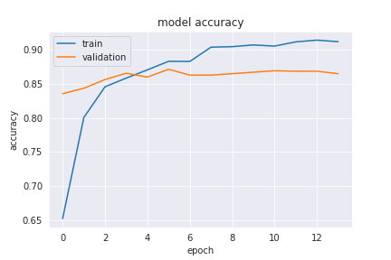
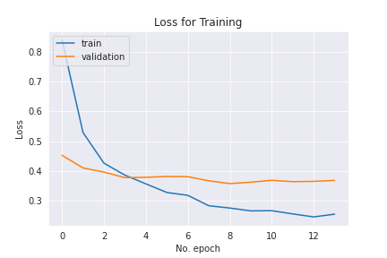
resnet50

Slide 34
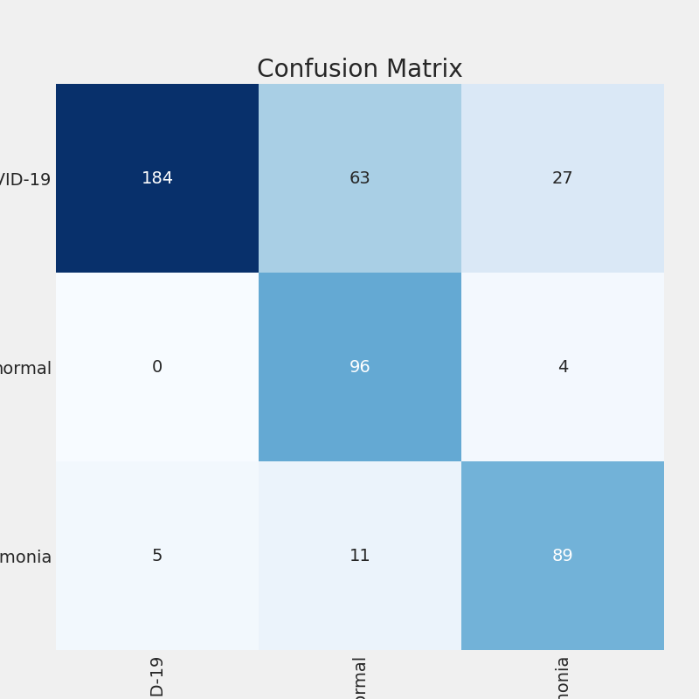
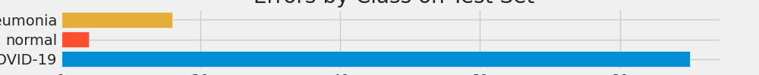
resnet50

Slide 35
resnet50
 | Precision | Recall | F1-score | Support
COVID19 | 0.97 | 0.67 | 0.79 | 274
Normal | 0.56 | 0.96 | 0.71 | 100
Pneumonia | 0.74 | 0.85 | 0.79 | 105
Accuracy: 0.77

Slide 36
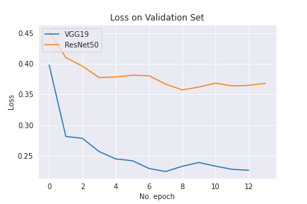
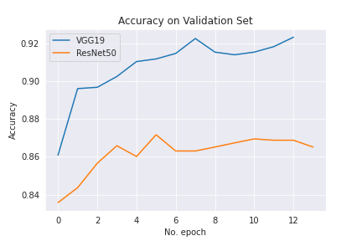
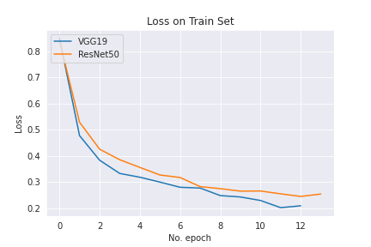
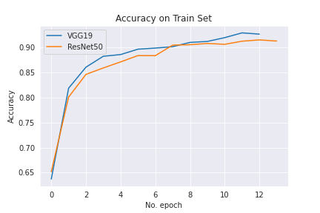
Resnet50 vs. vgg19

Slide 37
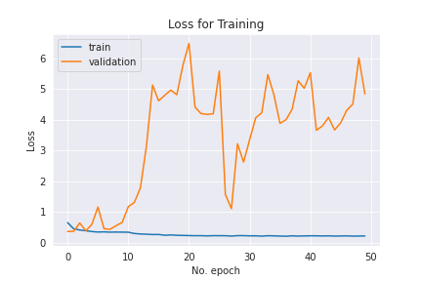
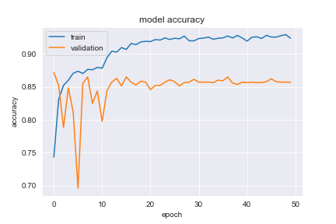
resnet50

Slide 38
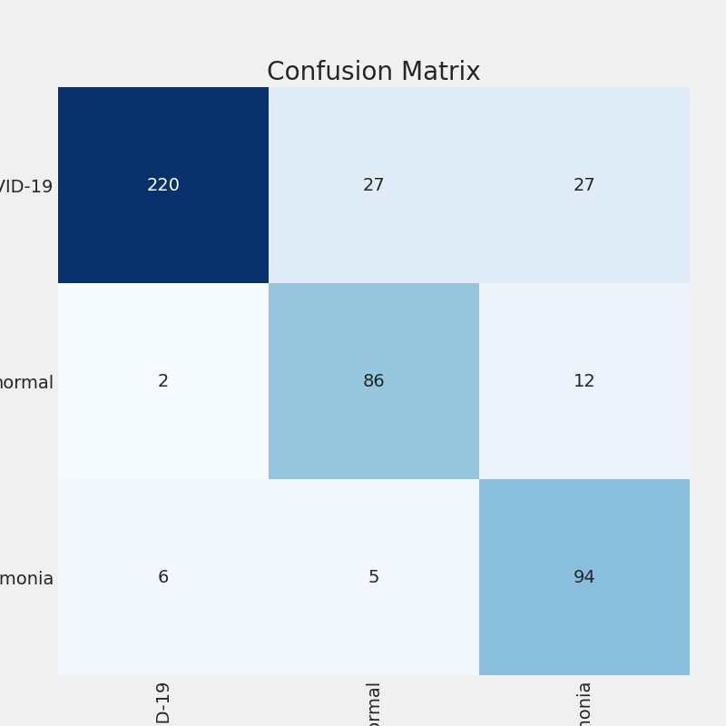
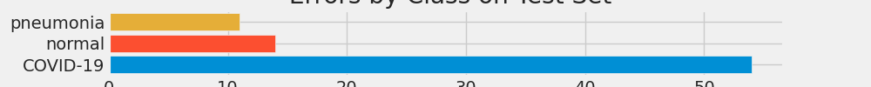
resnet50

Slide 39
resnet50
 | Precision | Recall | F1-score | Support
COVID19 | 0.96 | 0.80 | 0.88 | 274
Normal | 0.73 | 0.86 | 0.79 | 100
Pneumonia | 0.71 | 0.90 | 0.79 | 105
Accuracy: 0.84

Slide 40
performance
Architecture | Params (M) | Accuracy | Input resolution
VGG-19 (Wang et al., 2020) | 20.37 | 83%
VGG-19 | 29.76 trainable + 20.25 non-trainable | 86% | 480 x 480
ResNet-50 (Wang et al., 2020) | 24.97 | 90.6%
ResNet-50 (14 epoch) | 25.93 trainable + 23.77 non-trainable | 77% | 224 x 224
ResNet-50 (50 epoch) | 25.93 trainable + 23.77 non-trainable | 84% | 224 x 224
COVID-net (Wang et al., 2020) | 11.75 | 93.3% | 480 x 480

Slide 41
Sensitivity
Architecture | Normal | Pneumonia | COVID-19
VGG-19 (Wang et al., 2020) | 98% | 90% | 58.7%
VGG-19 | 96% | 86% | 82%
ResNet-50 (Wang et al., 2020) | 97% | 92% | 83%
ResNet-50 (14 epoch) | 96% | 85% | 67%
ResNet-50 (50 epoch) | 86% | 90% | 80%
COVID-net (Wang et al., 2020) | 95% | 94% | 91%

Slide 42
precision
Architecture | Normal | Pneumonia | COVID-19
VGG-19 (Wang et al., 2020) | 83.1% | 75% | 98.4%
VGG-19 | 70% | 80% | 99%
ResNet-50 (Wang et al., 2020) | 88.2% | 86.8% | 98.8%
ResNet-50 (14 epoch) | 56% | 74% | 97%
ResNet-50 (50 epoch) | 73% | 71% | 96%
COVID-net (Wang et al., 2020) | 90.5% | 91.3% | 98.9%

Slide 43
Future work

Slide 44
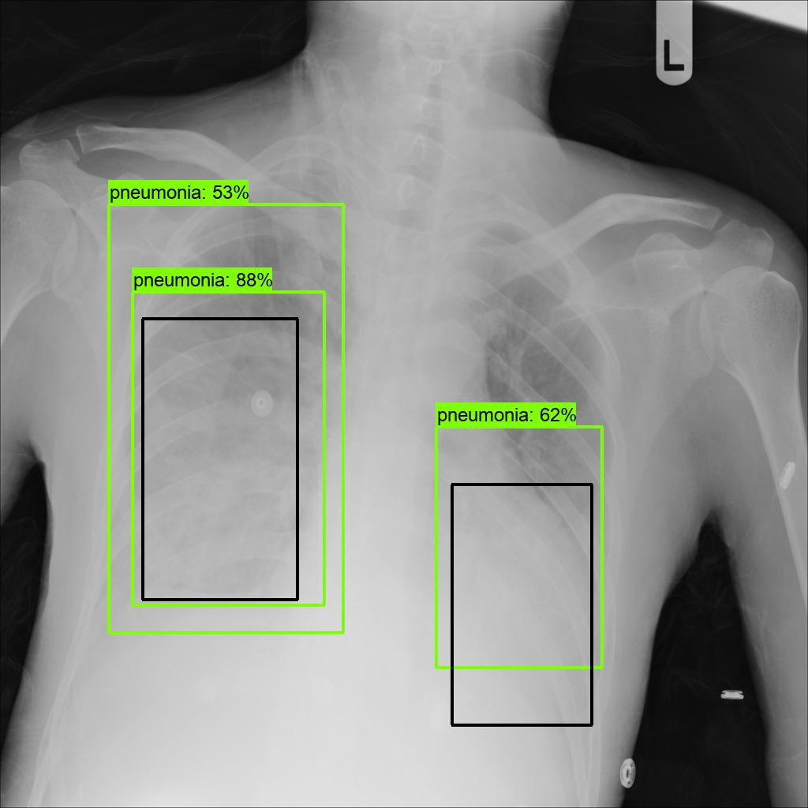
In reality, many COVID-19 patients has little or none damages around their lungs. Thus, their cases are classified as atype
For more persuasive, there is a should in using object detection problem
We also have to combine more data from patients for a better examination, e.g. age, race, gender, weight

Slide 45
References
[1] Cleverley, J.; Piper, J.; Jones, M.M. The role of chest radiography in confirming covid-19 pneumonia. BMJ 2020, 370.
[2] Wang, L., Lin, Z.Q. & Wong, A. COVID-Net: a tailored deep convolutional neural network design for detection of COVID-19 cases from chest X-ray images. Sci Rep 10, 19549 (2020). https://doi.org/10.1038/s41598-020-76550-z
[3] Cohen, J. P., Morrison, P., & Dao, L. COVID-19 image data collection. arXiv:2003.11597(2020)
[4] Chung, A. Figure 1 COVID-19 chest x-ray data initiative. https://github.com/agchung/Figure1-COVID-chestxray-dataset (2020)
[5] Chung, A. Actualmed COVID-19 chest x-ray data initiative. https://github.com/agchung/Actualmed-COVID-chestxray-dataset (2020)
[6] Radiological Society of North America. COVID-19 radiography database. https://www.kaggle.com/tawsifurrahman/covid19-radiography-database (2019)
[7] Radiological Society of North America. RSNA pneumonia detection challenge. https://www.kaggle.com/c/rsna-pneumonia-detection-challenge/data (2019).
[8] Krizhevsky, A., Sutskever, I. & Hinton, G. E. (2012). ImageNet Classification with Deep Convolutional Neural Networks. In F. Pereira, C. J. C. Burges, L. Bottou & K. Q. Weinberger (ed.), Advances in Neural Information Processing Systems 25 (pp. 1097--1105) . Curran Associates, Inc. .
[9] K. Simonyan et al., Very deep convolutional networks for large-scale image recognition, 2015.

